Slide 1
OMS Java/Web Application Development
Introduction to Bootstrap
November 2016

Slide 2
Agenda
What Bootstrap is for
Get Start
Components
Customization
Notes:
Bootstrap was developed by Mark Otto and Jacob Thornton at Twitter, and released as an open source product in August 2011 on GitHub.

Slide 3



What Bootstrap is for
Front-end framework for web development
HTML/CSS templates
Responsive Web Design
Advantages
Easy to start
Responsive features
Mobile supportability
Browser compatibility
Open source
Notes:
Responsive web design is about creating web sites which automatically adjust themselves to look good on all devices, from small phones to large desktops.

Slide 4
What Bootstrap is for
jQuery
Lightweight Javascript library
Feature-rich:
HTML/DOM manipulation
CSS manipulation
HTML Event methods
Effects and animation
AJAX
Bootstrap JS components build upon JQuery
JQuery Syntax
$(selector).action()
$: define/access JQuery
(selector): to query and find HTML elements
action(): action to be performed on the element(s)
e.g., $(“p”).hide(), $(“#mycarousel”).carousel(‘pause’)

Slide 5
What Bootstrap is for
jQuery Selectors
Any HTML element e.g., “p”, “button” etc.
Using an #id, e.g., “#myCarousel”
Class, e.g., “.btn”, “.btn.btn-default”
Attribute, e.g., “[href]”, “[data-toggle=“toolDp”]”
Current element: $(this).
And a lot more . . .

Slide 6
Get Start
Download
http://getbootstrap.com/getting-started#download
Folders and Files
bootstrap/
|--css/
|--css/bootstrap.min.css
|--css/bootstrap.min.css.map
|--css/bootstrap-theme.min.css
|--… …
|--fonts/
|--fonts/glyphicons-halflings-regular.eot
|--fonts/glyphicons-halflings-regular.svg
|--… …
|--js/
|--js/bootstrap.min.js
|--js/jquery-1.11.3.min.js
|--js/npm.js
|--… …
Notes:
If you don’t want to download, you can use Bootstrap CDN
<!-- Latest compiled and minified CSS -->
<link rel="stylesheet" href="http://maxcdn.bootstrapcdn.com/bootstrap/3.3.7/css/bootstrap.min.css">
<!-- jQuery library -->
<script src="https://ajax.googleapis.com/ajax/libs/jquery/1.12.4/jquery.min.js"></script>
<!-- Latest compiled JavaScript -->
<script src="http://maxcdn.bootstrapcdn.com/bootstrap/3.3.7/js/bootstrap.min.js"></script>
width=device-width: screen width based on device
initial-scale=1: for initial zoom level

Slide 7
Get Start
Basic Template
<!DOCTYPE html>
<html lang="en">
<head>
<meta charset="utf-8"> <meta http-equiv="X-UA-Compatible" content="IE=edge">
<meta name="viewport" content="width=device-width, initial-scale=1">
<title>Bootstrap Demo</title>
<link type="text/css" href="css/bootstrap.min.css" rel="stylesheet" />
</head>
<body>
<script type="text/javascript" src="js/jquery-1.11.3.min.js"></script>
<script type="text/javascript" src="js/bootstrap.min.js"></script>
<script type="text/javascript">
"use strict";
// your custom JS code goes here
</script>
</body>
</html>
Notes:
width=device-width: screen width based on device
initial-scale=1: for initial zoom level

Slide 8
Get Start
Container Class
.container (fixed-width)
.container-fluid (full-width)
<div class=“container”>
<div class=“row”>
<!-- … … //-->
</div>
</div>
<div class=“container-fluid”>
<div class=“row”>
<!-- … … //-->
</div>
</div>
Notes:
Container is not nestable
Use .container for a responsive fixed width container
Use .container-fluid for a full width container, spanning the entire width of your viewport.
Rows for horizontal groups

Slide 9

Get Start
Grid System
 | Phones <768px | Tablets >768px | PCs/Laptops >992px | Desktops >1200px
Max Container Width | Auto | 750px | 970px | 1170px
Class prefix | .col-xs- | .col-sm- | .col-md- | .col-lg-
Max Column Width | Auto | ~62px | ~81px | ~97px
Padding Width | 15px on each side
Notes:
xs-extra small
sm-small
md-medium
lg-large

Slide 10

Components
Typography
Heading
<div class=“page-header”>
<h1>Bootstrap <small>front-end framework</small></h1>
</div>
Paragraphs
<p class=“lead”>This is a paragraph</p>
Text Alignment
<p class=“text-left”>text on left</p>
Text Formatting
<p><del>This is deleted now…</del></p>
Text Transformation
<p class=“text-lowercase”>all text changed to lower cases</p>
Text Coloring
<p class=“text-muted”> This text is grayed out<p>
Notes:
Text alignment: text-left, text-center, text-right, text-justify, text-nowrap
Text formatting: <big/>, <small/>, <em/>, <mark/>, <ins/>, <del/>, <code/>, <i/>, <b/>
Text transformation: text-lowercase, text-uppercase, text-capitalize
Text coloring: text-muted, text-primary, text-success, text-info, text-warning, text-danger
Blockquotes: <cite/>, pull-right, and etc.

Slide 11
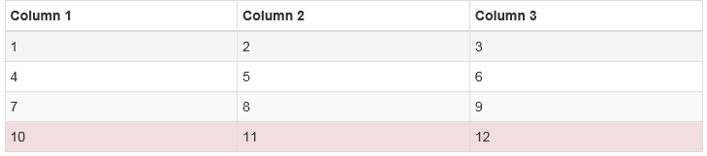

Components
Tables
<table class="table table-bordered table-striped table-hover table-condensed">
<thead>
<th>Column 1</th>
<th>Column 2</th>
<th>Column 3</th>
</thead>
<tbody>
<tr class=“danger">
<td>1</td><td>2</td> <td>3</td>
</tr>
… …
</tbody>
</table>

Slide 12
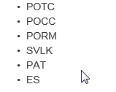
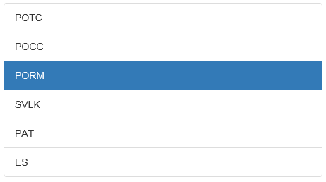
Components
Lists and List-Group (un-ordered, ordered)
HTML List | Bootstrap List Group
<ul> <li>POTC</li> <li>POCC</li> <li>PORM</li> <li>SVLK</li> <li>PAT</li> <li>ES</li> </ul> | <ul class="list-group"> <li class="list-group-item active">POTC</li> <li class="list-group-item">POCC</li> <li class="list-group-item">PORM</li> <li class="list-group-item">SVLK</li> <li class="list-group-item">PAT</li> <li class="list-group-item">ES</li> </ul>

Slide 13

Components
Navigations
<ul class="nav nav-tabs" role="tablist"> <li class="active"><a href="#potc" aria-controls="potc" role="tab" data-toggle="tab">POTC</a></li> <li><a href="#pocc" aria-controls="pocc" role="tab" data-toggle="tab">POCC</a></li> <li><a href="#porm" aria-controls="porm" role="tab" data-toggle="tab">PORM</a></li> <li><a href="#svlk" aria-controls="svlk" role="tab" data-toggle="tab">SVLK</a></li> <li><a href="#pat" aria-controls="pat" role="tab" data-toggle="tab">PAT</a></li> <li><a href="#es" aria-controls="es" role="tab" data-toggle="tab">ES</a></li> </ul> <div class="tab-content"> <div role="tabpanel" class="tab-pane fade in active" id="potc"> <p>PowerOn Trouble Center...</p> </div> <div role="tabpanel" class="tab-pane" id="pocc"> <p>PowerOn Control Center...</p> </div> <div role="tabpanel" class="tab-pane" id="porm"> <p>PowerOn Remote...</p> </div> <div role="tabpanel" class="tab-pane" id="svlk"> <p>Service Link...</p> </div> <div role="tabpanel" class="tab-pane" id="pat"> <p>Plant Alteration...</p> </div> <div role="tabpanel" class="tab-pane" id="es"> <p>Emergency Services...</p> </div> </div>
Notes:
.nav nav-tabsCreates navigation tabs
.nav-justified Makes navigation tabs/pills equal widths of their parent, at screens wider than 768px. On smaller screens, the nav tabs are stacked
.tab-content Together with .tab-pane and data-toggle="tab", it makes the tab toggable
.tab-paneTogether with .tab-content and data-toggle="tab", it makes the tab toggable

Slide 14


Components
Breadcrumbs
Pagination
<ul class=“breadcrumb" > <li class="active"><a href="#potc" >POTC</a></li> <li><a href="#pocc" >POCC</a></li> <li><a href="#porm" >PORM</a></li> <li><a href="#svlk" >SVLK</a></li> <li><a href="#pat" >PAT</a></li> <li><a href="#es" >ES</a></li> </ul>
<ul class="pagination" > <li class="active"><a href="#potc" >1</a></li> <li><a href="#pocc" >2</a></li> <li><a href="#porm" >3</a></li> <li><a href="#svlk" >4</a></li> <li><a href="#pat" >5</a></li> <li><a href="#es" >6</a></li> </ul>

Slide 15
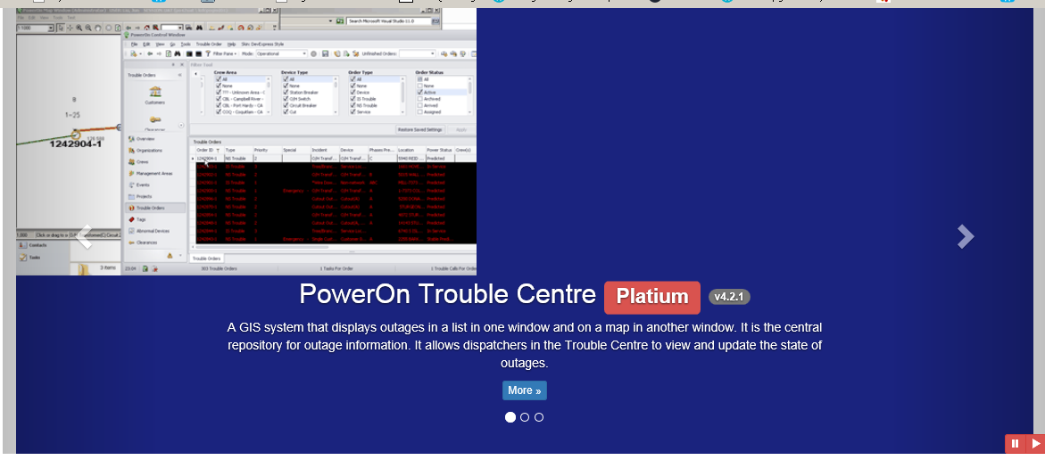
Components
Carousel

Slide 16
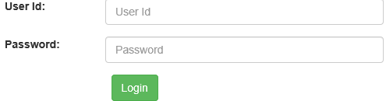
Components
Form Elements
<form class="form-horizontal"> <div class="form-group"> <label for="userId" class="control-label col-xs-3">User Id: </label> <div class="col-xs-9"> <input type="text" class="form-control" id="userId" placeholder="User Id" /> </div> </div> <div class="form-group"> <label for="passwd" class="control-label col-xs-3">Password: </label> <div class="col-xs-9"> <input type="password" class="form-control" id="passwd" placeholder="Password" /> </div> </div> <div class="col-xs-offset-3 col-xs-9"> <button class="btn btn-success" type="submit">Login</button> </div> </form>

Slide 17
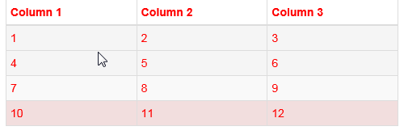
Customization
CSS Override
<!DOCTYPE html>
<html lang="en">
<head>
<link type="text/css" href="css/bootstrap.min.css" rel="stylesheet" />
<style type="text/css">
.table { color:red; }
</style>
</head>
<body>
<div class="container">
<table class="table table-bordered table-striped table-hover table-condensed">
<thead>
<th>Column 1</th>
</thead>
… …
</div>
</body>
</html>

Slide 18
Customization
Transition
Disabling Animation/Transition with JS
$.support.transition = false; // after bootstrap*.js loaded

Slide 19
More Examples
http://getbootstrap.com/components/
http://getbootstrap.com/getting-started/#examples

Slide 20
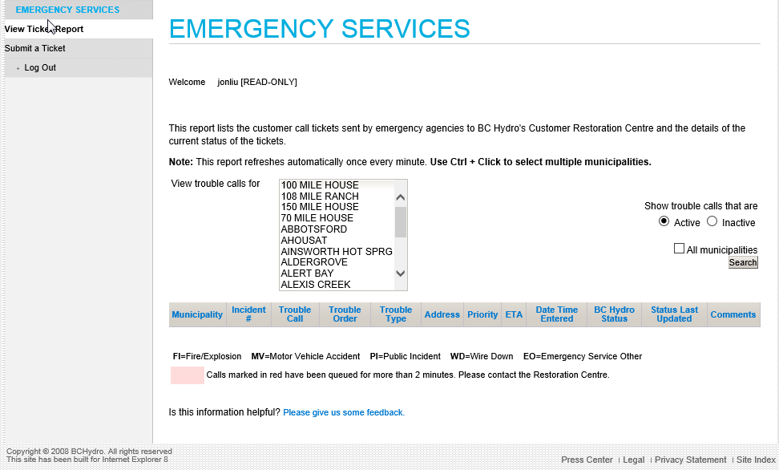
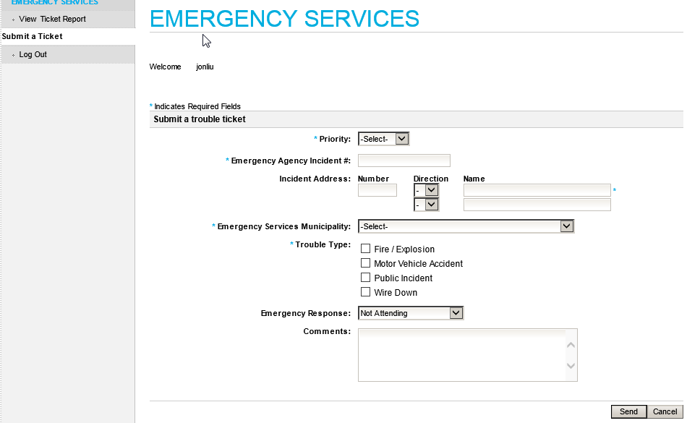
Emergency Services

Slide 21
References
http://getbootstrap.com/
http://www.w3schools.com/bootstrap/default.asp
https://www.tutorialspoint.com/bootstrap
http://www.tutorialrepublic.com/twitter-bootstrap-tutorial
http://fujitsu.skillport.com
Front-End Web UI Frameworks and Tools @ www.coursera.org

Slide 22
Q & A

